Slide 1




NEXT GEN EMPLOYABILITY PROGRAM
Creating a future-ready workforce
Team Members
College Name : PAAVAI COLLEGE OF ENGINEERING
NAMAKKAL
Student Name :BABUL T
Student ID :au622021104012

Slide 2

CAPSTONE PROJECT SHOWCASE
Project Title
Building Bus Reservation System using Python and Django
Abstract | Problem Statement | Project Overview | Proposed Solution | Technology Used | Modelling & Results | Conclusion

Slide 3
Abstract
Project Setup -Start by setting up a new Django project. Make sure you have Python and Django installed on your system.
Database Design: Design the database schema for your bus reservation system. You'll need tables/entities for buses, routes, schedules, reservations, users, etc. Utilize Django's built-in ORM (Object-Relational Mapping) to define your models.
Bus Management: Create views and forms to allow administrators to manage buses, routes, schedules, etc. This includes adding, editing, and deleting bus information.
Reservation System: Implement functionality for users to search for available buses based on their preferred route and date. Allow users to reserve seats on a selected bus.
Source :

Slide 4
Problem Statement
User Authentication:
Users should be able to register for an account and log in securely.
Only logged-in users should be able to make reservations.
Seat Selection:
Users should be able to view available seats for a particular bus route.
Seats should be displayed in a visually understandable layout, allowing users to select seats easily.
Once a seat is selected, it should be marked as unavailable for other users.
Source :

Slide 5
Project Overview
Project Setup: First, make sure you have Python and Django installed on your system. You can create a new Django project using the django-admin command.
Define Models: In each app, define Django models to represent the data entities in your system. For example, you might have models like User, Bus, Route, Reservation, etc. Use Django's ORM to define relationships between these models.
python manage.py startapp users
python manage.py startapp buses
python manage.py startapp reservations
Source :

Slide 6
Proposed Solution
.
Setup Django Project: Start by creating a new Django project. You can do this by running the following command in your terminal:
Implement Templates: Create HTML templates to render the views and forms. You can use Django's template language to dynamically generate content.
Add Business Logic: Implement business logic to handle tasks like checking bus availability, calculating fares, validating reservation requests, etc.
Source :

Slide 7

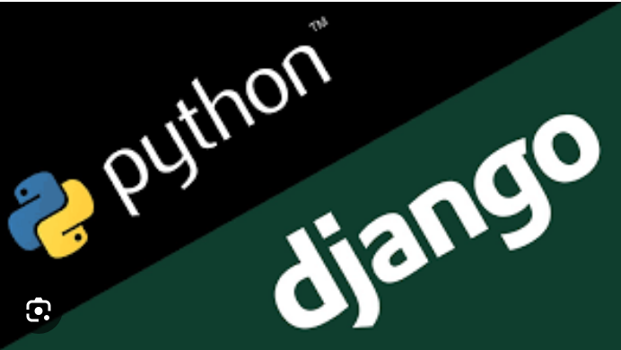
Technology Used
Front-end
Back-end
Source :

Slide 8
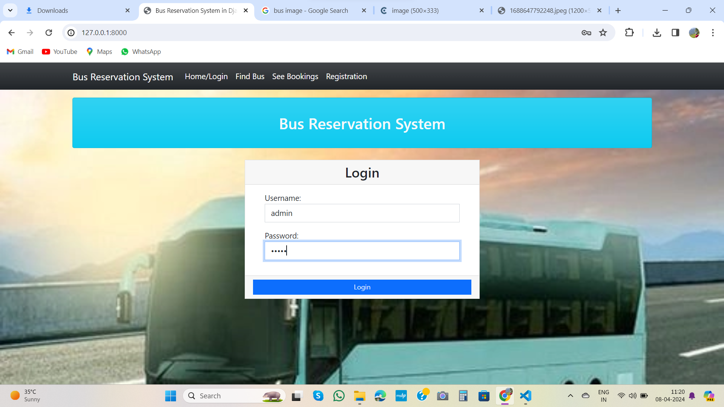
Login

Slide 9
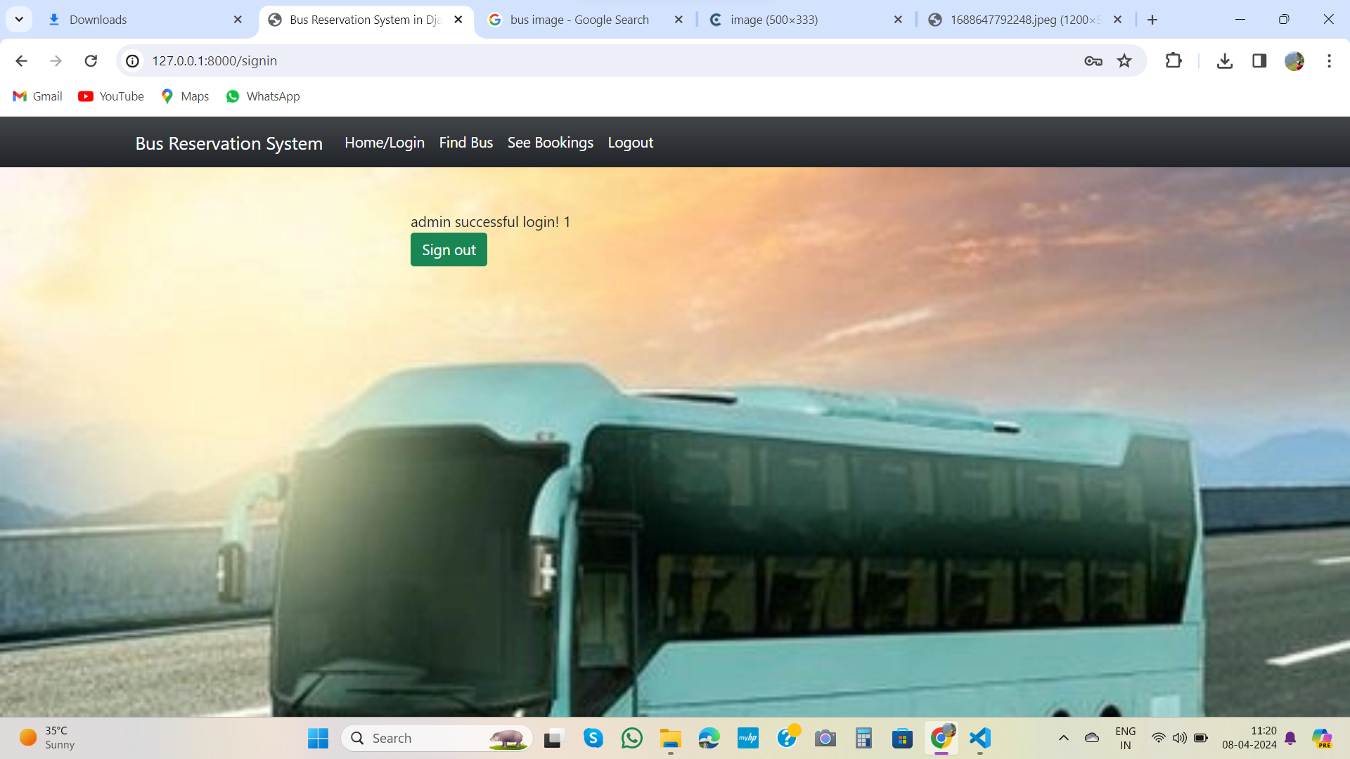
LOGIN SUCCESSFUL

Slide 10
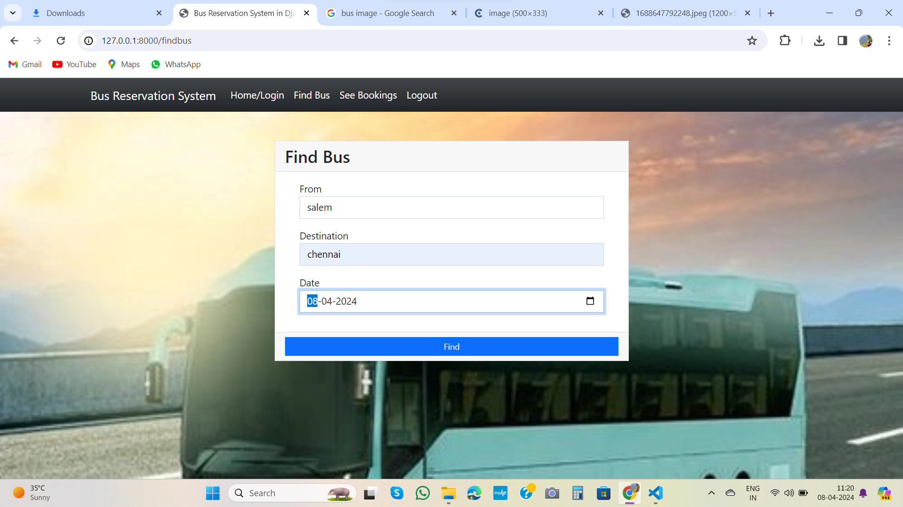
Find bus-Page

Slide 11
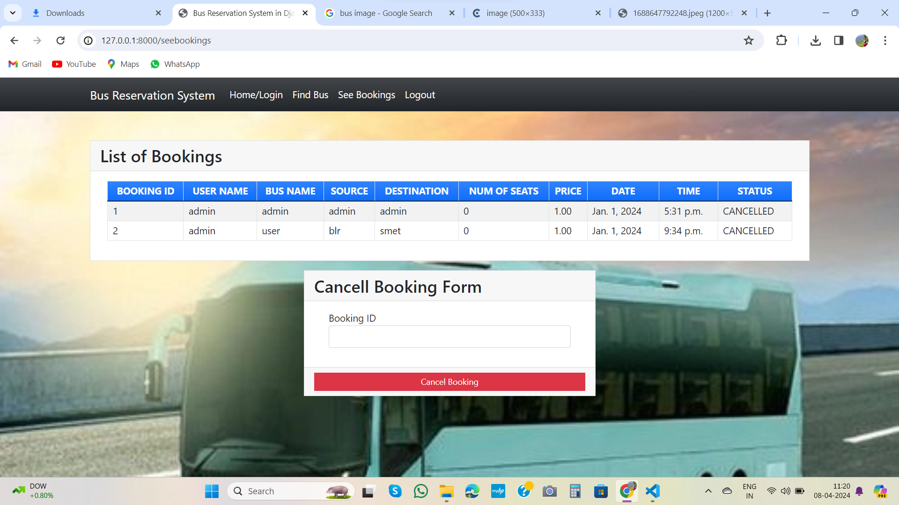
Cancell Booking Form-Page

Slide 12
Thank You!
Notes:
Thank You !!

